Slide 1
Module 2 (App. A)
Test Automation—JUnit©

Slide 2
Outline
Unit Test
Unit Test Automation
What is JUnit
Why use JUnit
Terminology
JUnit Fixtures
JUnit Assert Methods
DEMO

Slide 3
Unit Test
A unit test is a piece of code written by a developer that executes a specific functionality in the software under test (SUT).
Unit tests ensure that code is working as intended and validate that this is still the case after code changes.

Slide 4
Unit Test Automation (1/2)
For a large system, there can be thousands of unit tests, which can be tedious to maintain and execute.
Many advocate that unit test cases should be automated.
Automation is achieved by automatically setting up a testing context, calling each test case, verifying their corresponding expected result, and reporting the status of all tests.
These test cases are then added to the code base (along with the code) and are re-run whenever new code is added to the code base.
If new code breaks an old test case, it is easy to know right away that the new code broke some already implemented functionality.
Easily isolating the defect is of prime importance!

Slide 5
Unit Test Automation (2/2)
Once you have written code that implements new functionality and this code passes its unit test cases,
These test cases are then referred to as ‘regression’ test cases.
Can be combined with the use of a Software Versioning Repository.
Prior to any commit being made, unit testing is re-applied to make sure that the committed code is still working properly.

Slide 6
What is JUnit? (1/2)
Open source Java testing framework used to write and run repeatable automated tests
JUnit is open source (junit.org)
A structure for writing test drivers
JUnit features include:
Assertions for testing expected results
Test features for sharing common test data
Test suites for easily organizing and running tests
Graphical and textual test runners
JUnit is widely used in industry
JUnit can be used as stand alone Java programs (from the command line) or within an IDE such as Eclipse

Slide 7
What is JUnit? (2/2)
It is an instance of the xUnit architecture for unit testing frameworks: Perl, C++, Python, Visual Basic, C#, etc.
Using JUnit you can easily and incrementally build a test suite that will help you measure your progress, spot unintended side effects, and focus your development efforts.
Test Cases and Test Results are Java objects.
JUnit is a regression testing framework.
The test framework provides tools for:
assertions.
running tests.
aggregating tests (suites).
reporting results.

Slide 8
Why use JUnit?
JUnit tests allow you to write code faster while increasing quality:
less debugging time
more confidence
JUnit is simple: compiler tests syntax, JUnit tests integrity.
JUnit tests check their own results and provide immediate feedback.
JUnit test can be composed into a hierarchy of test suites.
Create test assets:
Retain their value and can be run and interpreted by other than original author.
Effective, open source, integrated.

Slide 9
Example: Old Way vs. New Way
@Test void testMax() { assertEquals(7, max(3, 7)); assertEquals(3, max(3, -7)); }
int max(int a, int b) { if (a > b) { return a; } else { return b; } }
void testMax() { int x = max(3, 7); if (x != 7) { System.out.println("max(3, 7) gives " + x); } x = max(3, -7); if (x != 3) { System.out.println("max(3, -7) gives " + x); } }
public static void main(String[] args) { new MyClass().testMax(); }

Slide 10
Terminology
A unit test is a test of a single class.
A test case tests the response of a single method to a particular set of inputs.
Test fixture refers to the fixed state used as a baseline for running tests.
The purpose of a test fixture is to ensure that there is a well known and fixed environment in which tests are run so that results are repeatable.
A test fixture sets up the data (both objects and primitives) that are needed to run tests.
Examples:
If you are testing code that updates employee record, you need an employee record to test it on.
Loading a database with a specific, known set of data

Slide 11
Fixtures (1/2)
Handle common objects under test.
setUp() and tearDown() used to initialize and release common objects.
setUp() initializes fields, turns on logging, resets environment variables, and so forth, i.e. it sets up a context for the test cases to be applied
tearDown() used to do a cleanup operation. For example we can call the garbage collector in case our tests consume large amount of memory.
The JUnit framework automatically invokes the setUp() method before each test is run and the tearDown() method after each test is run.

Slide 12
Fixtures (2/2)
Separation of the test initialization (and destruction) from the testing
Used to ensure that there are no side effects between tests.
Enforce the test independence rule, test execution order is not guaranteed.
it is not certain that JUnit will run these tests in any specific order. Running the tests on different platforms and Java VMs may therefore yield different results.

Slide 13
Fixtures in JUnit 4
In JUnit 4, the initialization method no longer needs to be called setUp(). We can give it a more natural name and annotate it with the @Before annotation.
We can have multiple methods noted @Before, each running before testing.
@Before
void initialize()
{
System.out.println("Before testing");
}
In JUnit 4, release method is annotated with @After.
@After
void disposeObjects ()
{
System.out.println(“After testing");
System.gc();
}

Slide 14
@BeforeClass and @AfterClass
For expensive setup, such as when you need to connect to a database to do your testing
If you wish, you can declare one method to be executed just once, when the class is first loaded
@BeforeClass public static void setUpClass() { // one-time initialization code }
If you wish, you can declare one method to be executed just once, to do cleanup after all the tests have been completed
@AfterClass public static void tearDownClass() { // one-time cleanup code }

Slide 15
Writing a JUnit Test Class (1/2)
Start by importing these JUnit 4 classes:
import org.junit.*; import static org.junit.Assert.*; // note static import
Declare your test class in the usual way
public class MyProgramTest {
Declare an instance of the class being tested
You can declare other variables, but don’t give them initial values here
public class MyProgramTest { MyProgram program; int someVariable;
Notes:
The static import declaration is analogous to the normal import declaration. Where the normal import declaration imports classes from packages, allowing them to be used without package qualification, the static import declaration imports static members from classes, allowing them to be used without class qualification.

Slide 16
Writing a JUnit Test Class (2/2)
Define a method (or several methods) to be executed before each test. Initialize your variables in this method, so that each test starts with a fresh set of values.
@Before public void setUp() { program = new MyProgram(); someVariable = 1000; }
You can define one or more methods to be executed after each test.
Typically such methods release resources, such as files. Usually there is no need to bother with this method
@After public void tearDown() { }

Slide 17
A Simple Example
Suppose you have a class Arithmetic with methods
int multiply(int x, int y) and boolean isPositive(int x)
import org.junit.*; import static org.junit.Assert.*;
public class ArithmeticTest { @Test public void testMultiply() { assertEquals(4, Arithmetic.multiply(2, 2)); assertEquals(-15, Arithmetic.multiply(3, -5)); }
@Test public void testIsPositive() { assertTrue(Arithmetic.isPositive(5)); assertFalse(Arithmetic.isPositive(-5)); assertFalse(Arithmetic.isPositive(0)); } }

Slide 18
JUnit assert Methods (1/2)
Assert within a test:
Call the method being tested and get the actual result.
assert what the correct result should be with one of the provided assert methods.
static void assertTrue(boolean test) static void assertTrue(String message, boolean test)
Throws an AssertionFailedError if the test fails (the optional message is included in the Error)
static void assertFalse(boolean test) static void assertFalse(String message, boolean test)
Throws an AssertionFailedError if the test fails.
assertEquals(expected, actual) assertEquals(String message, expected, actual)
For objects, uses your equals method, if you have defined it properly, as public boolean equals(Object o)--otherwise it uses ==

Slide 19
Warning: equals
You can compare primitives with ==
Java has a method x.equals(y), for comparing objects
This method works great for Strings and a few other Java classes
For objects of classes that you create, you have to define equals
assertEquals(expected, actual) uses == or equals
To define equals for your own objects, define exactly this method: public boolean equals(Object obj) { ... }
The argument must be of type Object, which isn’t what you want, so you must cast it to the correct type (say, Person):
public boolean equals(Object something) { Person p = (Person)something; return this.name == p.name; // test whatever you like here }

Slide 20
JUnit assert Methods (2/2)
assertSame(Object expected, Object actual) assertSame(String message, Object expected, Object actual)
Asserts that two objects refer to the same object (using ==).
assertNotSame(Object expected, Object actual)
assertNotSame(String message, Object expected, Object actual)
Asserts that two objects do not refer to the same object.
assertNull(Object object) assertNull(String message, Object object)
Asserts that the object is null.
assertNotNull(Object object) assertNotNull(String message, Object object)
Asserts that the object is not null.
fail() fail(String message)
Causes the test to fail and throw an AssertionFailedError
Useful as a result of a complex test, when the other assert methods aren’t quite what you want.

Slide 21
Special Features of @Test
You can limit how long a method is allowed to take
This is good protection against infinite loops
The time limit is specified in milliseconds
The test fails if the method takes too long
@Test (timeout=10) public void greatBig() { assertTrue(program.ackermann(5, 5) > 10e12); }
Some method calls should throw an exception
You can specify that a particular exception is expected
The test will pass if the expected exception is thrown, and fail otherwise
@Test (expected=IllegalArgumentException.class) public void factorial() { program.factorial(-5); }

Slide 22
Ignoring a Test
The @Ignore annotation says to not run a test
@Ignore("I don’t want Dave to know this doesn’t work") @Test public void add() { assertEquals(4, program.sum(2, 2)); }
Don’t use @Ignore without a very good reason!

Slide 23
Parameterized Test (via constructor)
Run the same test over and over again using different values
Five steps:
Annotate test class with @RunWith(Parameterized.class)
Create a public static method annotated with @Parameters that returns a Collection of Objects (as Array) as test data set.
Create a public constructor that takes in what is equivalent to one "row" of test data.
Create an instance variable for each "column" of test data.
Create your test case(s) using the instance variables as the source of the test data.

Slide 24
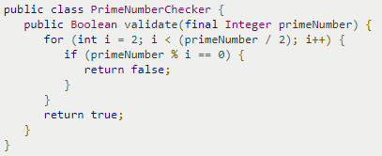
Example: Parameterized Test
Notes:
Check also @theory and @DataPoints

Slide 25
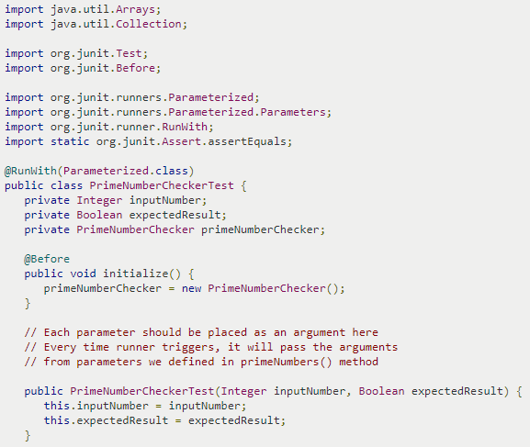

Slide 26
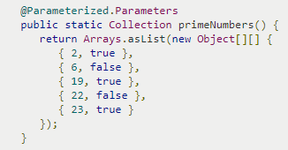
This test will run 5 times since we have 5 parameters defined
Notes:
primeNumbers() can be replaced by any name, example data().
Also can be defined as follows: public static Collection<Object[]> data()

Slide 27
Test suites
You can define a suite of tests
import org.junit.runner.RunWith;
import org.junit.runners.Suite;
import org.junit.runners.Suite.SuiteClasses;
@RunWith(value=Suite.class) @SuiteClasses(value={ MyProgramTest.class, AnotherTest.class, YetAnotherTest.class }) public class AllTests { }
Note that “value=“ can be omitted
Notes:
“Value=“ can be removed.

Slide 28
Test-Driven Development (TDD)
It’s actually better to write the tests before writing the code you want to test
When tests are written first, you have a clearer idea what to do when you write the methods
Because the tests are written first, the methods are necessarily written to be testable
Writing tests first encourages you to write simpler, single-purpose methods

Slide 29
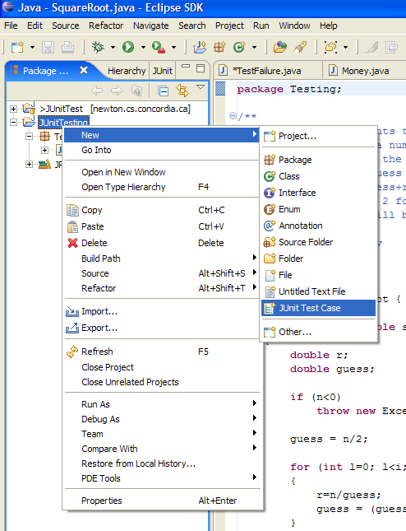
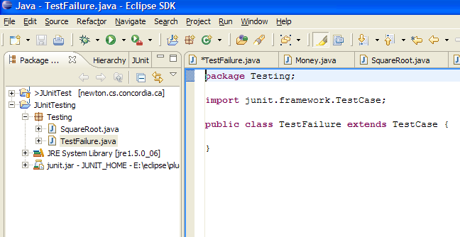
Test Runners: Eclipse JUnit
Eclipse comes with both JUnit and a plug-in for creating and working with JUnit tests.
Eclipse allows you to quickly create test case classes and test suite classes to write your test code in
Put the test case class into the same package as the tested class.

Slide 30
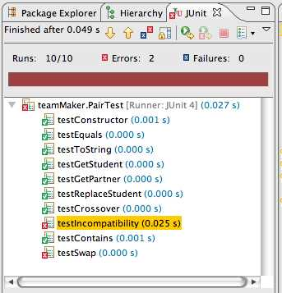
Viewing results in Eclipse
Ran 10 of
the 10 tests
No tests
failed, but...
Something unexpected
happened in two tests
Bar is green if
all tests pass,
red otherwise
This is how
long the
test took
This test passed
Something is wrong
Depending on your
preferences, this
window might show
only failed tests

Slide 31
Test Runners: Eclipse JUnit
You can also run your tests from via your own code. The org.junit.runner.JUnitCore class provides the runClasses() method which allows you to run one or several tests classes. As a return parameter you receive an object of the type org.junit.runner.Result. This object can be used to retrieve information about the tests.
In your test folder create a new class MyTestRunner with the following code. This class will execute your test class and write potential failures to the console.
package myJUnitTest;
import org.junit.runner.JUnitCore;
import org.junit.runner.Result;
import org.junit.runner.notification.Failure;
public class MyTestRunner {
public static void main(String[] args) {
Result result = JUnitCore.runClasses(MyClassTest.class);
for (Failure failure : result.getFailures()) {
System.out.println(failure.toString());
}
}
}

Slide 32
Test Suites: Advantages and Disadvantages
Obviously you have to test your code to get it working in the first place:
You can do ad hoc testing (running whatever tests occur to you at the moment).
You can build a test suite (a thorough set of tests that can be run at any time).
Disadvantages of a test suite:
It’s a lot of extra programming:
This is true, but use of a good test framework can help quite a bit.
You don’t have time to do all that extra work:
False--Experiments repeatedly show that test suites reduce debugging time more than the amount spent building the test suite.
Advantages of a test suite:
Reduces total number of bugs in delivered code.

Slide 33
JUnit Testing Tips
Code a little, test a little, code a little, test a little . . .
Run your tests as often as possible, at least as often as you run the compiler.
Begin by writing tests for the areas of the code that you’re the most worried about . . .write tests that have the highest possible return on your testing investment.
When you need to add new functionality to the system, write the tests first.
If you find yourself debugging using System.out.println(), write a test case instead.
When a bug is reported, write a test case to expose the bug.
Don’t deliver code that doesn’t pass all the tests.
Separate production and test code:
But typically in the same packages.

Slide 34
DEMO
(JUnitDemo.pdf)

Slide 35
Resources
Some JUnit tutorials
http://open.ncsu.edu/se/tutorials/junit/
Laurie Williams, Dright Ho, and Sarah Smith
http://www.laliluna.de/eclipse-junit-testing-tutorial.html
Sascha Wolski and Sebastian Hennebrueder
http://www.diasparsoftware.com/template.php?content=jUnitStarterGuide
Diaspar software
http://www.clarkware.com/articles/JUnitPrimer.html
Clarkware consulting
http://www.vogella.com/articles/JUnit/article.html
JUnit – Eclipse Tutorial (by Lars Vogel)
http://junit.sourceforge.net/doc/testinfected/testing.htm
JUnit Test Infected: Programmers Love Writing Tests
http://code.google.com/p/t2framework/wiki/JUnitQuickTutorial
Junit Quick Tutorial
http://www.javaworld.com/jw-12-2000/jw-1221-junit.html
JUnit Best Practices: Techniques for building resilient, relocatable, multithreaded JUnit tests
JUnit: Download, Documentation
http://www.junit.org/

Slide 36
Summary
The only way to make testing efficient as well as effective is to automate as much as possible
Test frameworks provide very simple ways to automate our tests
It is no “silver bullet” however … it does not solve the hard problem of testing :
What test values to use ?
This is test design … the purpose of test criteria

